Slide 1
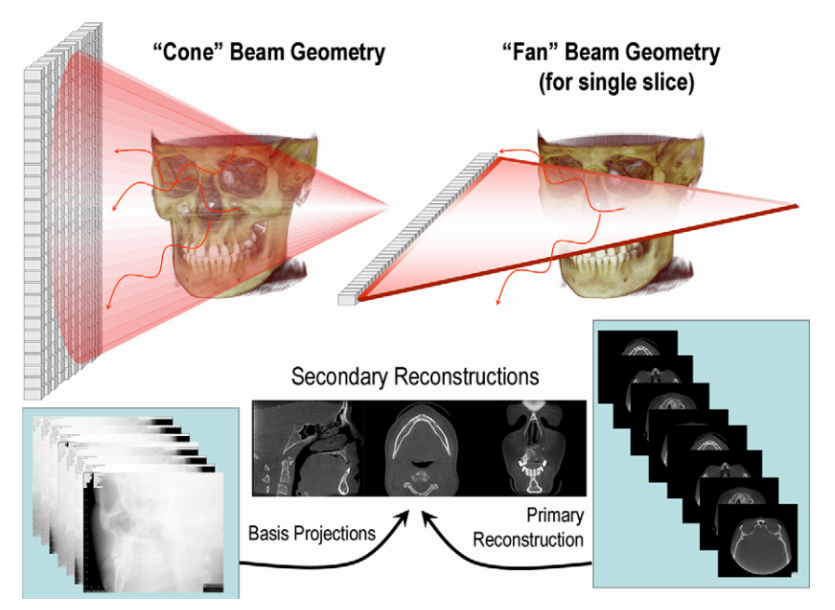
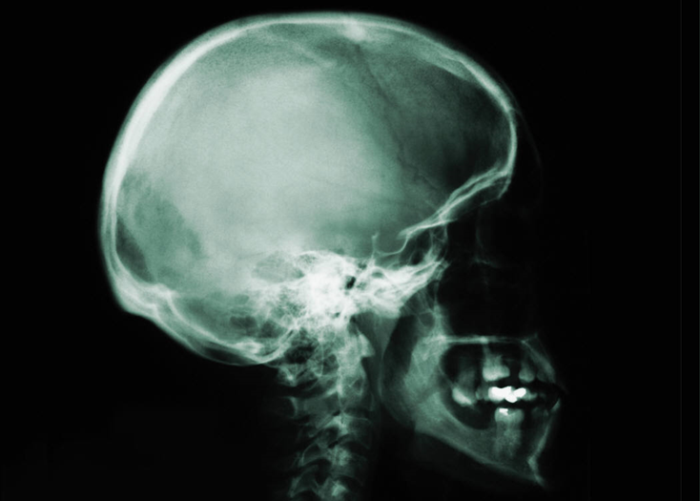
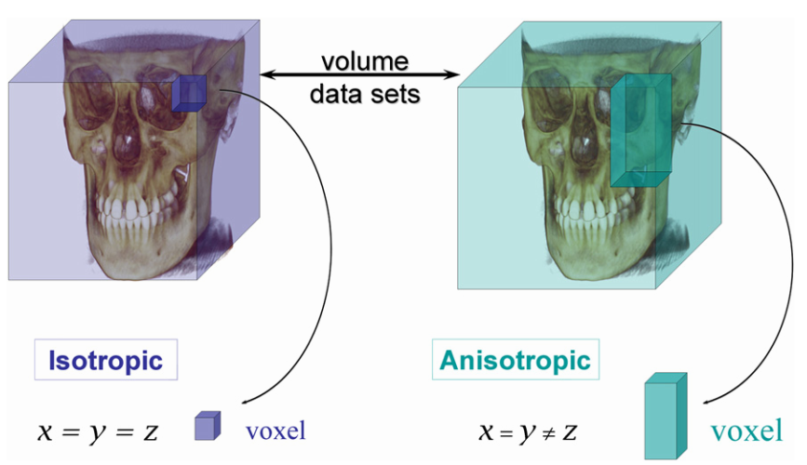
Convolutional Neural Network for Cone Beam-CT Segmentation
Introduction
Motivation :
Image segmentation -> based on non-supervised pattern classification techniques.
In image segmentation, different features are extracted and grouped into different clusters->useful information of differently grouped semantic regions.
In surgical simulation -> bone models are used for planning or maxillofacial surgery.
Aim :
Develop and implement semantic segmentation of CBCT volumes into air, soft tissue and bone using Convolutional Neural Network framework.
Data :
Head and Neck Cone Beam-CT (CBCT).
Advantages: Low Dose Radiation, shorter acquisition time, reduced cost.
Disadvantages: scattered radiation, artifacts, limited FOV.
Source : What is Cone-Beam CT and How Does it Work?

Slide 2
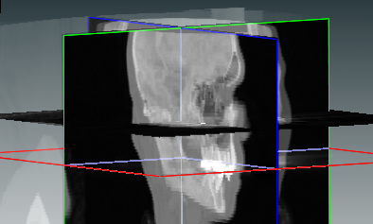
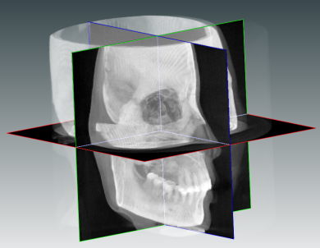
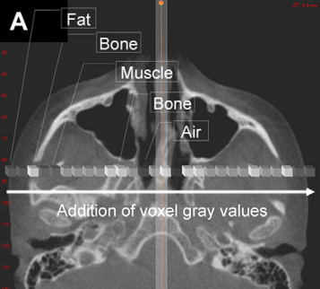
Test
Workflow
CT
CBCT

Slide 3
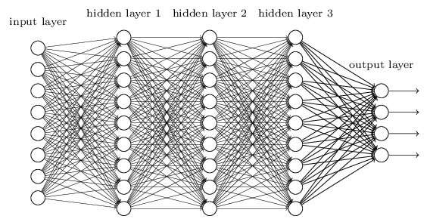
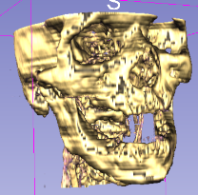
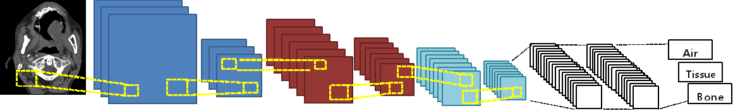
Test
Method
Convolutional Neural Network (CNN/ConvNet)
Source : http://neuralnetworksanddeeplearning.com/chap6.html
An illustration of ConvNet architecture applied for CBCT Images
Convolution
+ ReLU
Pooling
Convolution
+ ReLU
Pooling
Pooling
Fully Connected
Fully Connected
Convolution
+ ReLU
Feature Extraction from Image
Classification
Notes:
here are four main operations in the ConvNet shown in figure above:
1. Convolution - > The primary purpose of Convolution in case of a ConvNet is to extract features from the input image. Convolution preserves the spatial relationship between pixels by learning image features using small squares of input data.
2. Non Linearity (ReLU)->ReLU stands for Rectified Linear Unit and is a non-linear operation. The purpose of ReLU is to introduce non-linearity in our ConvNet, since most of the real-world data we would want our ConvNet to learn would be non-linear (Convolution is a linear operation – element wise matrix multiplication and addition, so we account for non-linearity by introducing a non-linear function like ReLU)
3. Pooling or Sub Sampling -> reduces the dimensionality of each feature map but retains the most important information. Spatial Pooling can be of different types: Max, Average, Sum etc.
4. Classification (Fully Connected Layer) ->The output from the convolutional and pooling layers represent high-level features of the input image. The purpose of the Fully Connected layer is to use these features for classifying the input image into various classes based on the training dataset.

Slide 4
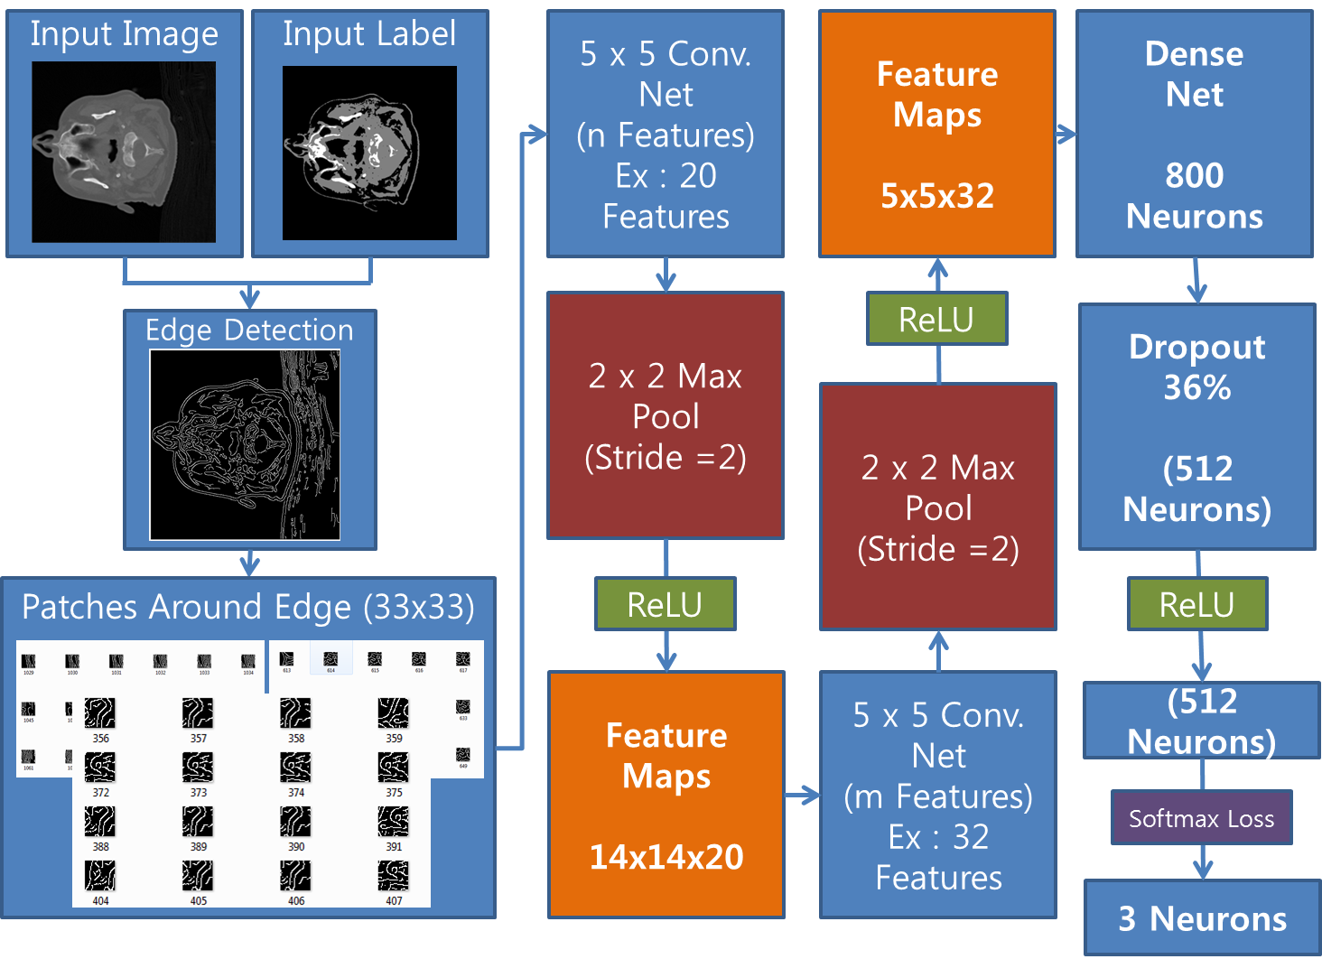
Test
The Architecture of The Convolutional Neural Network – 2D
Notes:
here are four main operations in the ConvNet shown in figure above:
1. Convolution - > The primary purpose of Convolution in case of a ConvNet is to extract features from the input image. Convolution preserves the spatial relationship between pixels by learning image features using small squares of input data.
2. Non Linearity (ReLU)->ReLU stands for Rectified Linear Unit and is a non-linear operation. The purpose of ReLU is to introduce non-linearity in our ConvNet, since most of the real-world data we would want our ConvNet to learn would be non-linear (Convolution is a linear operation – element wise matrix multiplication and addition, so we account for non-linearity by introducing a non-linear function like ReLU)
3. Pooling or Sub Sampling -> reduces the dimensionality of each feature map but retains the most important information. Spatial Pooling can be of different types: Max, Average, Sum etc.
4. Classification (Fully Connected Layer) ->The output from the convolutional and pooling layers represent high-level features of the input image. The purpose of the Fully Connected layer is to use these features for classifying the input image into various classes based on the training dataset.

Slide 5
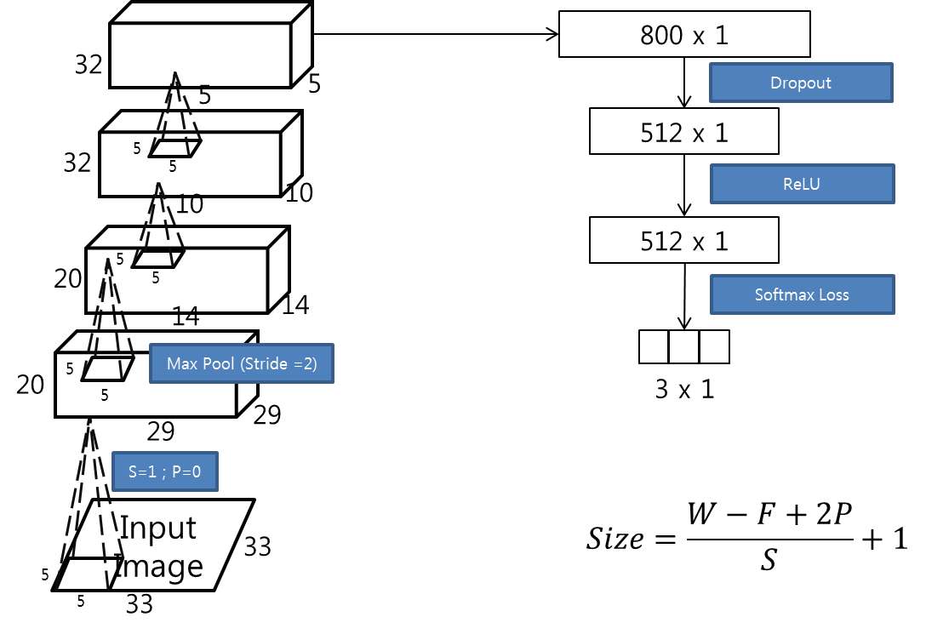
Test
The Architecture of The Convolutional Neural Network – 2D

Slide 6

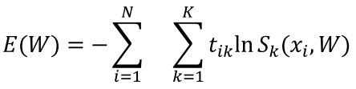
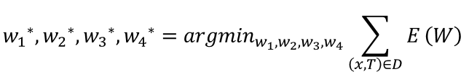
Test
The Architecture of The Convolutional Neural Network – 2D
A feed-forward network can be taken as a stream of linearly stacked non-linear functions :
Each functional block f_{L,wL} takes an input x_{L} along with some parameters to compute an output x_{L+1}. x₁ is a 2D square patch, with single label belong to the center pixel of the patch. The output of the proposed architecture can be written as :
C_{n},p_{n} and f_{n} are the n^{th} convolution, pooling and fully connected blocks.
R and s are ReLU and softmax operator.
w_{n} are weight vectors corresponding to convolution or fully connected blocks
a_{n} is pooling window of the nth pooling block
y is the posterior probability vector of size 1 x 3.
Minimize the error between y and the ground truth. The error function is written as :
W is weight vector
N is batch size
the error minimization problem can be stated as :

Slide 7
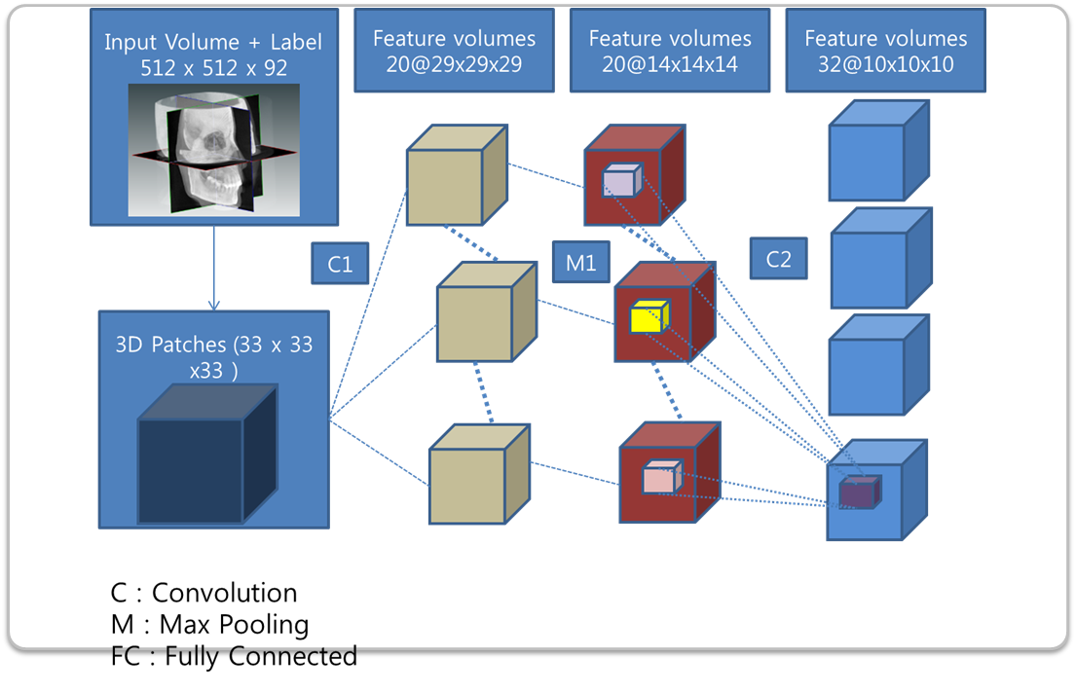
Test
The Architecture of The Convolutional Neural Network – 3D

Slide 8
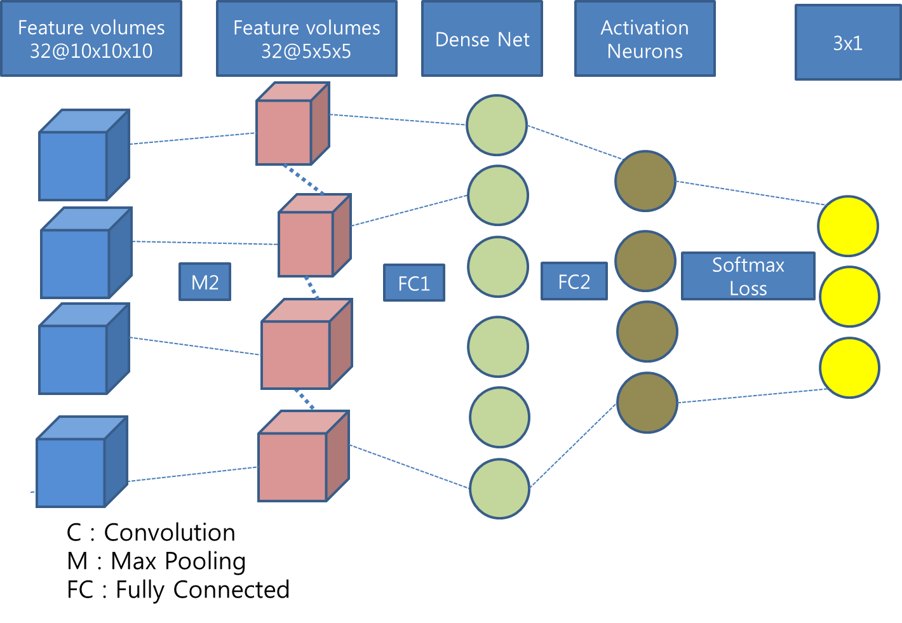
Test
The Architecture of The Convolutional Neural Network – 3D

Slide 9
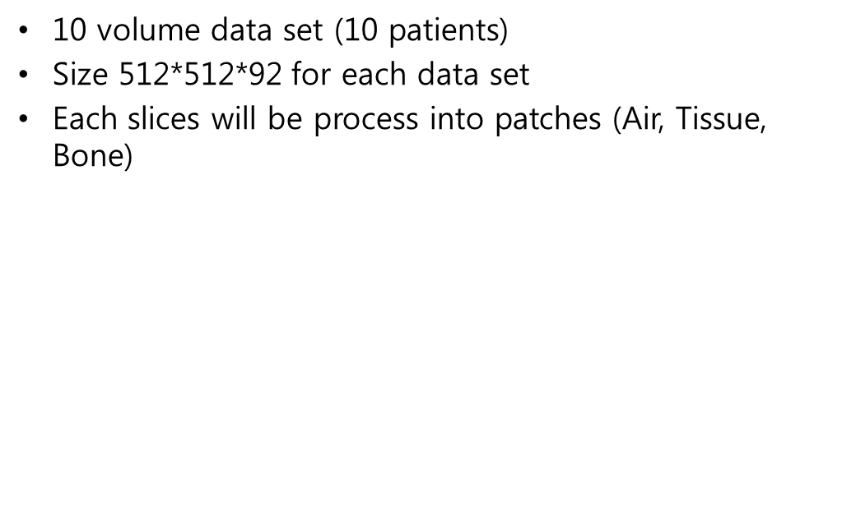
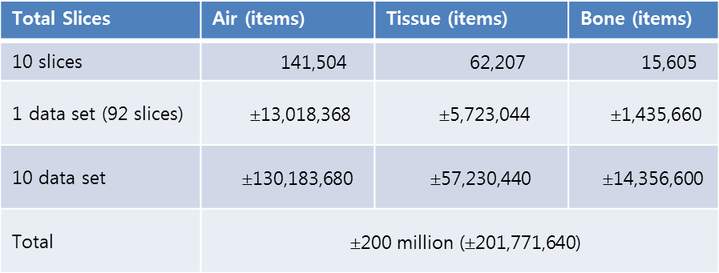
Test
Data

Slide 10
References
Scarfe, W. C., & Farman, A. G. (2008). What is Cone-Beam CT and How Does it Work? Dental Clinics of North America. http://doi.org/10.1016/j.cden.2008.05.005
Long, J., Shelhamer, E., & Darrell, T. (2015). Fully convolutional networks for semantic segmentation. In Proceedings of the IEEE Computer Society Conference on Computer Vision and Pattern Recognition (Vol. 07–12-June-2015, pp. 3431–3440). http://doi.org/10.1109/CVPR.2015.7298965
Neural Networks and Deep Learning. http://neuralnetworksanddeeplearning.com
Comparative Study of Deep Learning Software Frameworks
Deep Learning Tutorial
http://deeplearning.net/tutorial/lenet.html
Semantic Segmentation: SegNet: A Deep Convolutional Encoder-Decoder Architecture for Robust Semantic Pixel-Wise Labelling http://arxiv.org/abs/1505.07293
Szegedy, C., Liu, W., Jia, Y., Sermanet, P., Reed, S., Anguelov, D., Erhan, D., Vanhoucke, V., Rabinovich, A. (2015). Going Deeper with Convolutions. CVPR2015.http://www.cv-foundation.org/openaccess/content_cvpr_2015/papers/Szegedy_Going_Deeper_With_2015_CVPR_paper.pdf

Slide 11
Thank You

